Slide 1


Fashion Images Classification
VALLURU, ESWAR(27)
SIRASANAGANDLA, BHAVYA SRI(21)
NADIMPELLI, MANIDEEP(16)

Slide 2
Fashion Images Classification
Visual classification of commercial products is a branch of the wider fields of object detection and feature extraction in computer vision, and, in particular, it is an important step in the creative workflow in fashion industries. Automatically classifying garment features makes both designers and data experts aware of their overall production, which is fundamental in order to organize marketing campaigns, avoid duplicates, categorize apparel products for e-commerce purposes, and so on. Specifically, both deep learning and image processing techniques, such as template matching, were used. The result is a novel system for image recognition and feature extraction that has a high classification accuracy and which is reliable and robust enough.

Slide 3


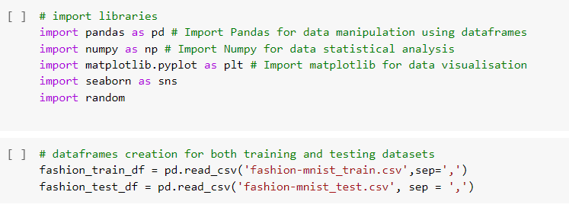
Loading Data

Slide 4
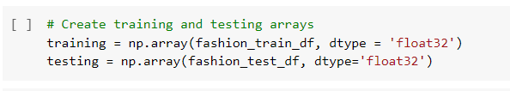
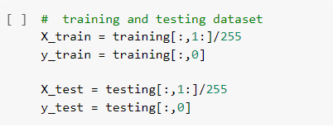
Scaling

Slide 5

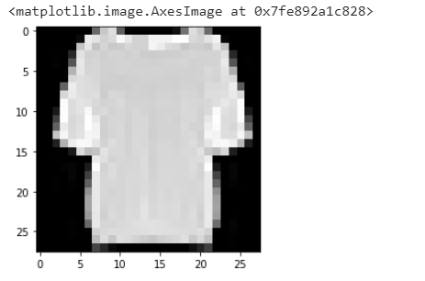
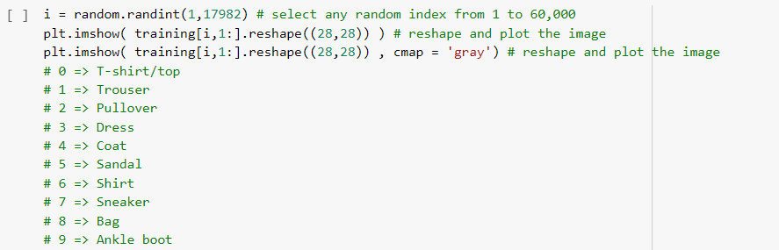
Reshape & Plotting

Slide 6
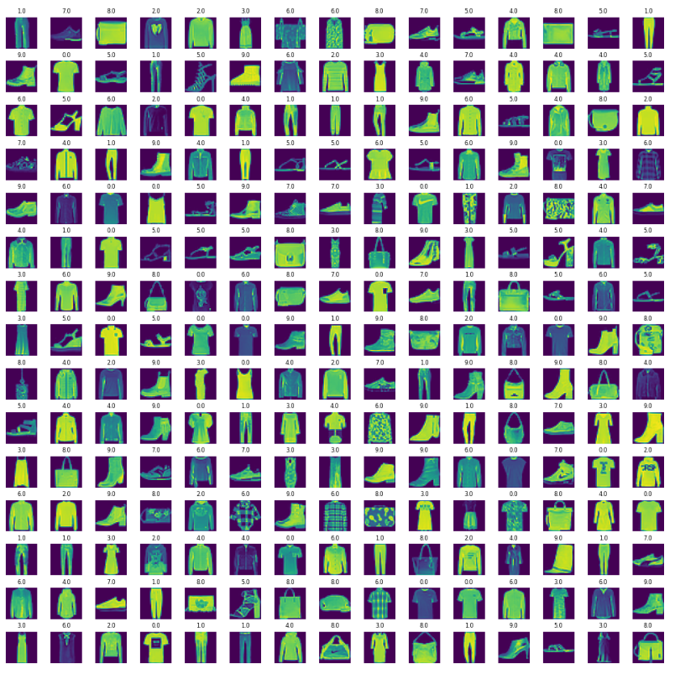
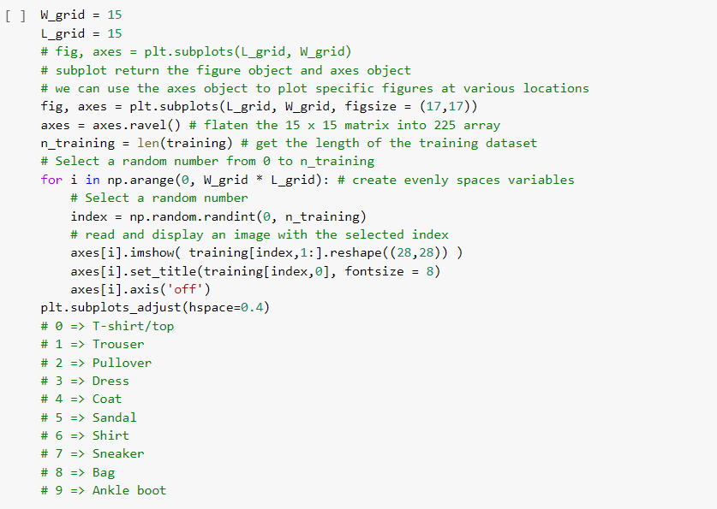
Plotting Data

Slide 7
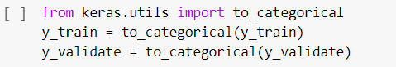
Scaling & Splitting

Slide 8
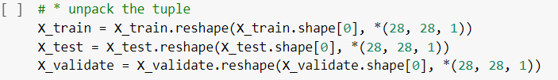
Reshaping

Slide 9
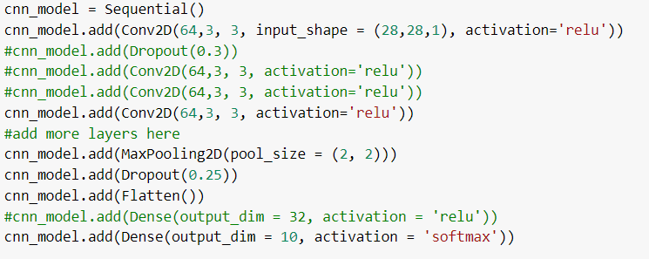
Building Model

Slide 10
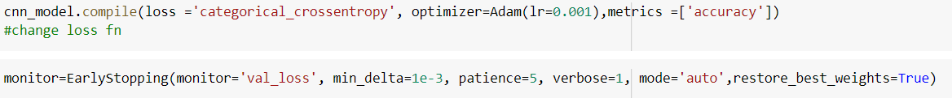
Compiling and Callbacks

Slide 11
Early Stopping
A callback is an object that can perform actions at various stages of training (e.g. at the start or end of an epoch, before or after a single batch, etc).
You can use callbacks to:
Write TensorBoard logs after every batch of training to monitor your metrics
Periodically save your model to disk
Do early stopping
Get a view on internal states and statistics of a model during training

Slide 12
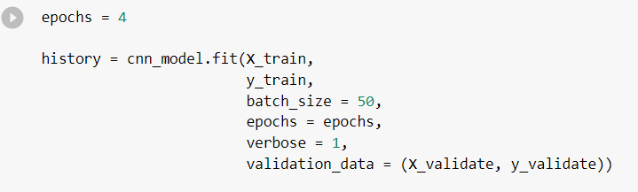
Fitting the Model

Slide 13
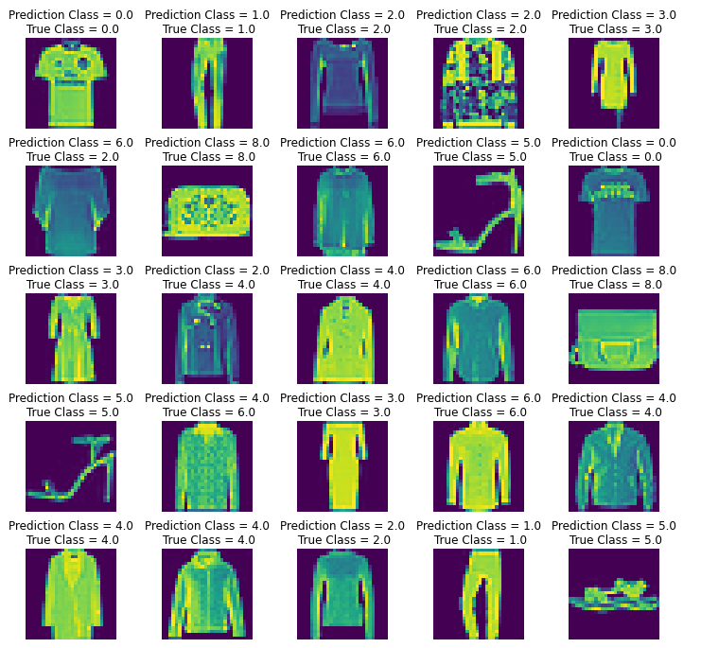
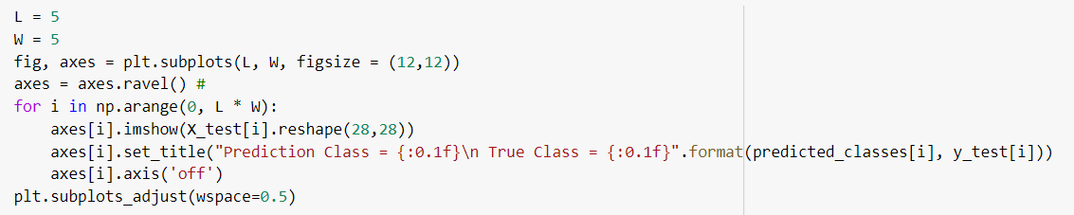
Predicting

Slide 14
Confusion Matrix
A confusion matrix is a table that is often used to describe the performance of a classification model (or “classifier”) on a set of test data for which the true values are known. It allows the visualization of the performance of an algorithm.
In the field of machine learning and specifically the problem of statistical classification, a confusion matrix, also known as an error matrix, is a specific table layout that allows visualization of the performance of an algorithm, typically a supervised learning one.

Slide 15
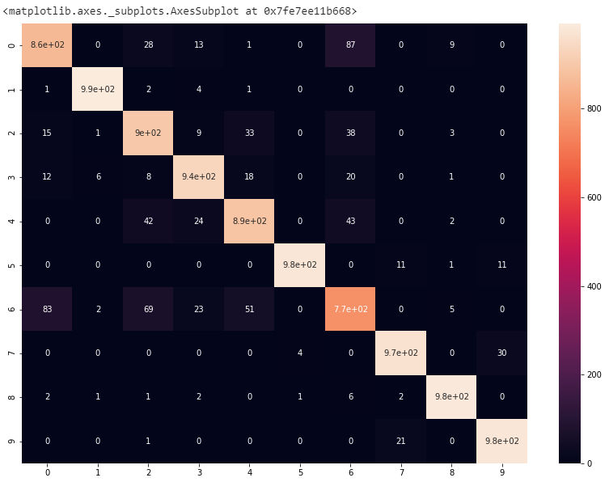
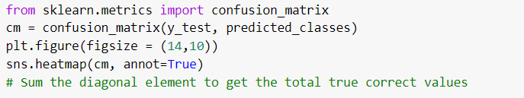
Confusion Matrix

Slide 16
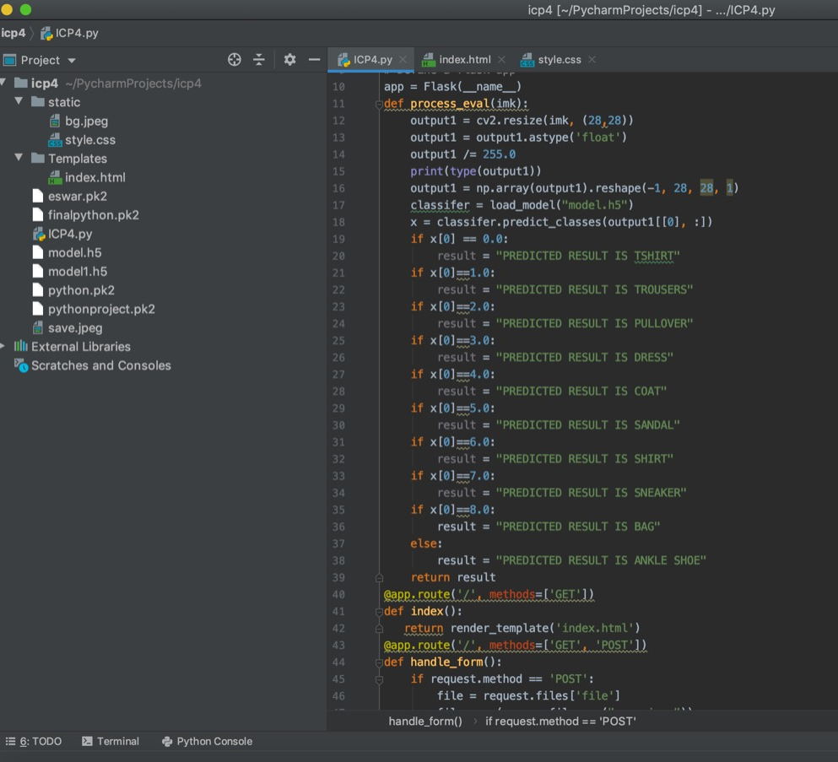
Flask Code

Slide 17
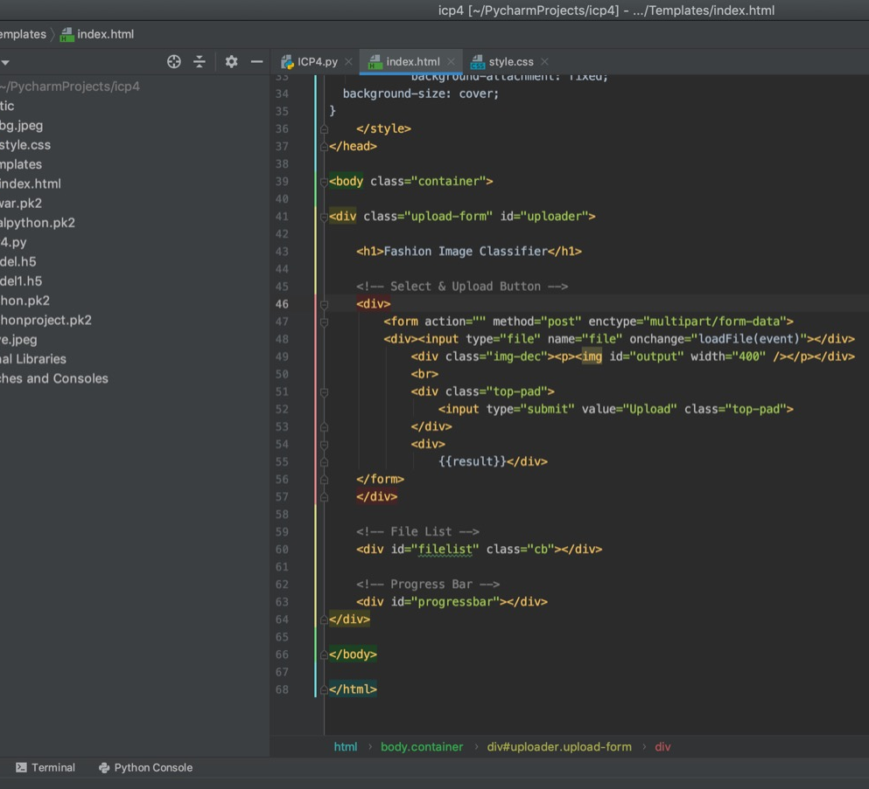
HTML Page

Slide 18
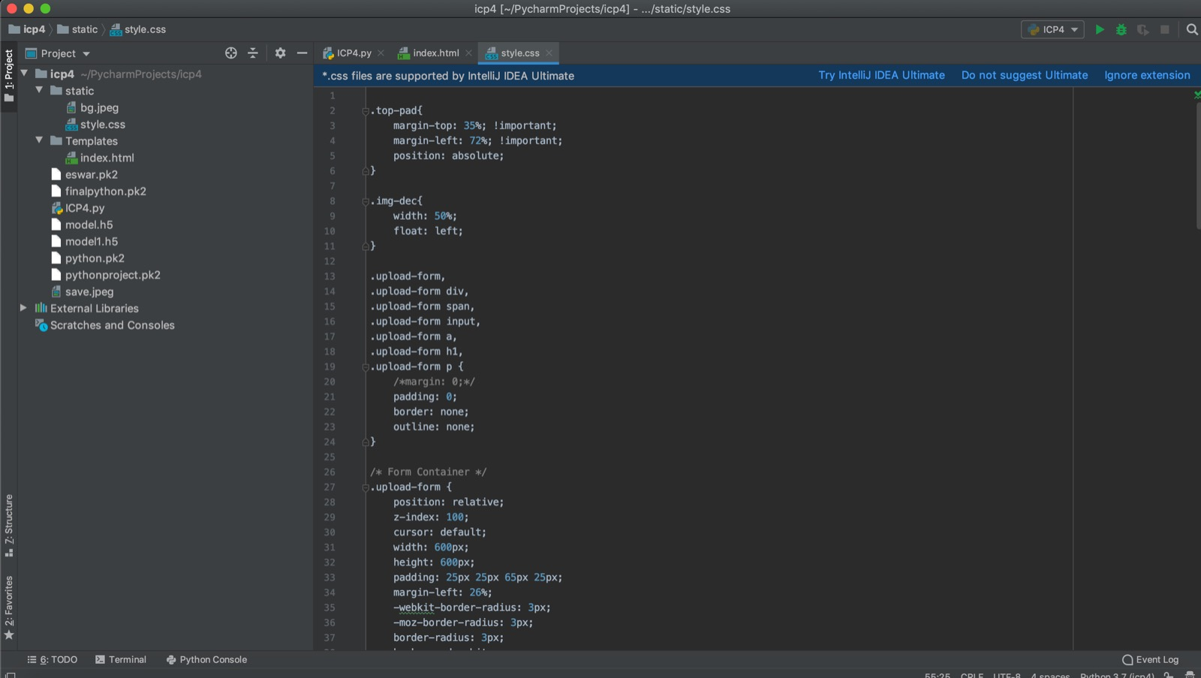
CSS File

Slide 19

Landing Page

Slide 20


Slide 21


Slide 22


Slide 23
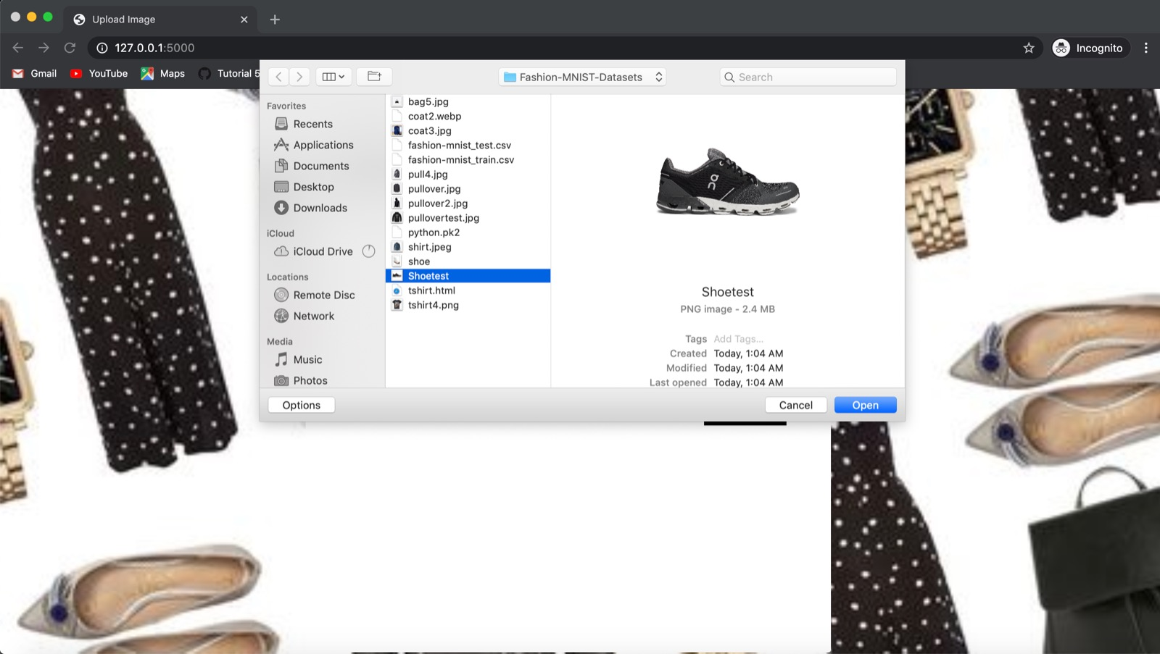

Slide 24


Slide 25


Slide 26


